Slide 1
Foundation of AI lab
Project: Cam Scanner using Python
Guided by: Sukhmeet Singh

Slide 2
Created by
Ashish Kumar (20BCS4910)
Shruti Sehgal (20BCS4949)
Chetan Kumar (20BCS4906)
Mandeep Kaur (20BCS4907)
Sahul Kumar Parida (20BCS4919)

Slide 3
Index
Introduction
What is AI?
What is Cam Scanner?
What is OpenCV?
Pre-processing the image using different concepts such as blurring, thresholding, denoising (Non-Local Means).
Canny Edge detection & Extraction of biggest contour
Sharpening & Brightness correction
Libraries
Code
Output
Conclusion

Slide 4
Introduction
Have you ever wondered how a ‘CamScanner’ converts your mobile camera’s fuzzy document picture into a defined, properly lit and scanned image? I have and until recently I thought it was a very difficult task. But it’s not and we can make our own ‘CamScanner’ with relatively few lines of python code.
We have made a project on Cam Scanner using python language. CamScanner is the best scanner app that will turn your device into a PDF scanner. Convert images to pdf in a simple tap. In this project, we have explained the significance of the application and it's working followed by libraries used and also their outcome with conclusion.

Slide 5
What is Artificial Intelligence?
In computer science, the term artificial intelligence (AI) refers to any human-like intelligence exhibited by a computer, robot, or other machine. In popular usage, artificial intelligence refers to the ability of a computer or machine to mimic the capabilities of the human mind—learning from examples and experience, recognizing objects, understanding and responding to language, making decisions, solving problems—and combining these and other capabilities to perform functions a human might perform, such as greeting a hotel guest or driving a car.

Slide 6
What is Cam Scanner?
Cam Scanner is an application that turns your smartphone into a image scanner. It is very convenient tool and easy to use. It has the ability to quickly scan all types of paper documents. Some of the most striking features include the ability to send scanned documents anywhere. The auto enhances functionality ensures that you get the best quality and clear PDFs that look clear and sharp, not forgetting the optical character recognition that helps your extract texts from images for edits and sharing. Rotate, crop, brighten and more with just a few clicks before exporting to file to be saved wherever you want. You can never get enough of this fantastic application.

Slide 7
What is OpenCV?
OpenCV is a library of programming functions mainly aimed at real-time computer vision. Originally developed by Intel, it was later supported by Willow Garage and then Itseez. The library is cross-platform and free for use under the open-source BSD license. It was initially developed in C++ but now it’s available across multiple languages such Python, Java, etc.

Slide 8
Start with Pre-processing BLURRING
The goal of blurring is to reduce the noise in the image. It removes high frequency content (e.g: noise, edges) from the image — resulting in blurred edges. There are multiple blurring techniques (filters) in OpenCV, and the most common are:
Averaging — It simply takes the average of all the pixels under kernel area and replaces the central element with this average
Gaussian Filter — Instead of a box filter consisting of equal filter coefficients, a Gaussian kernel is used
Median Filter — Computes the median of all the pixels under the kernel window and the central pixel is replaced with this median value
Bilateral Filter — Advanced version of Gaussian blurring. Not only does it remove noise, but also smoothens edges.

Slide 9
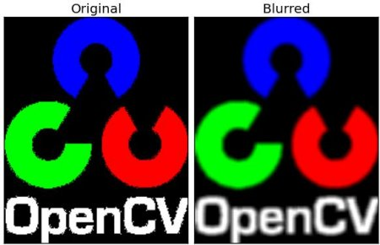

Slide 10
THRESHOLDING
In image processing, thresholding is the simplest method of segmenting images. From a grayscale image, thresholding can be used to create binary images. This is generally done so as to clearly differentiate between different shades of pixel intensities. Most common thresholding techniques in OpenCV are:
Simple Thresholding — If pixel value is greater than a threshold value, it is assigned one value (may be white), else it is assigned another value (may be black)
Adaptive Thresholding — Algorithm calculates the threshold for a small regions of the image. So we get different thresholds for different regions of the same image and it gives us better results for images with varying illumination

Slide 11
DENOISING
There is another kind of de-noising that we conduct —Non-Local Means Denoising. The principle of the initial denoising methods were to replace the colour of a pixel with an average of the colours of nearby pixels. The variance law in probability theory ensures that if nine pixels are averaged, the noise standard deviation of the average is divided by three. Hence giving us a denoised picture.
But what if there is edge or elongated pattern where denoising by averaging won’t work. Therefore, we need to scan a vast portion of the image in search of all the pixels that really resemble the pixel we want to denoise. Denoising is then done by computing the average colour of these most resembling pixels. This is called Non-Local Means Denoising.

Slide 12
Canny Edge detection & Extraction of biggest contour
After image blurring & thresholding, the next step is to find the biggest contour (biggest bounding box) and crop out the image. This is done by using Canny Edge Detection followed by extraction of biggest contour using four-point transformation.
CANNY EDGE
Canny edge detection is a multi-step algorithm that can detect edges. We should send a de-noised image to this algorithm so that it is able to detect relevant edges only.

Slide 13
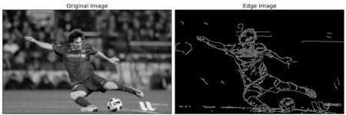

Slide 14
FIND CONTOURS
After finding the edges, pass the image through cv2.findcontours(). It joins all the continuous points (along the edges), having same color or intensity. After this we will get all contours — rectangles, spheres, etc.
EXTRACTING THE BIGGEST CONTOUR
Although we have found the biggest contour which looks like a rectangle, we still need to find the corners so as to find the exact co-ordinates to crop the image.

Slide 15
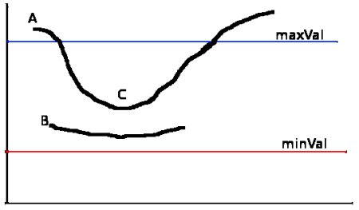
Hysteresis Thresholding
This stage decides which are all edges are really edges and which are not. For this, we need two threshold values, minVal and maxVal. Any edges with intensity gradient more than maxVal are sure to be edges and those below minVal are sure to be non-edges, so discarded. Those who lie between these two thresholds are classified edges or non-edges based on their connectivity. If they are connected to “sure-edge” pixels, they are considered to be part of edges. Otherwise, they are also discarded.

Slide 16
The edge A is above the maxVal, so considered as “sure-edge”. Although edge C is below maxVal, it is connected to edge A, so that also considered as valid edge and we get that full curve. But edge B, although it is above minVal and is in same region as that of edge C, it is not connected to any “sure-edge”, so that is discarded. So it is very important that we have to select minVal and maxVal accordingly to get the correct result.
This stage also removes small pixels noises on the assumption that edges are long lines.
So what we finally get is strong edges in the image.

Slide 17
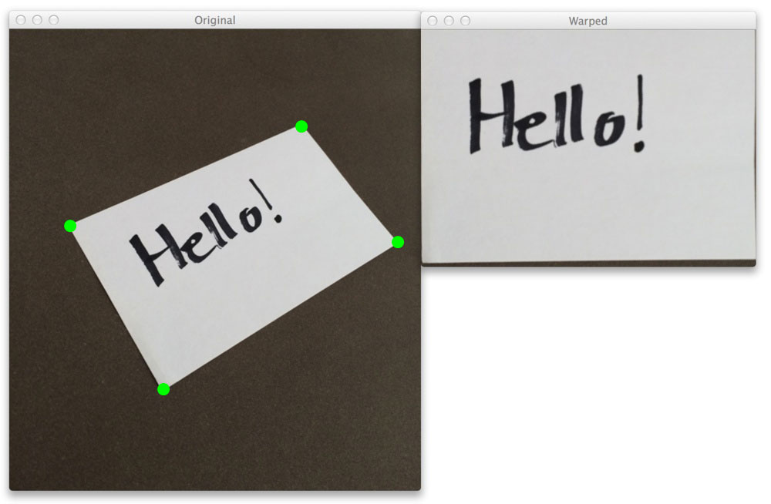

Slide 18
Finally — Sharpening & Brightness correction
Now that we have cropped out the relevant info (biggest contour) from the image, the last step is to sharpen the picture so that we get well illuminated and readable document.
For this we use hue, saturation, value (h,s,v) concept where value represents the brightness. You can play around with this value to increase the brightness of the documents
Kernel Sharpening - A kernel, convolution matrix, or mask is a small matrix. It is used for blurring, sharpening, embossing, edge detection, and more. This is accomplished by doing a convolution between a kernel and an image

Slide 19
Libraries Used
We are using three libraries in our project code.
They are as follows:-
CV2
Numpy
Mapper

Slide 20
1.CV2-OpenCV
OpenCV is a cross-platform library using which we can develop real-time computer vision applications. It mainly focuses on image processing, video capture and analysis including features like face detection and object detection.
It is a huge open-source library for computer vision, machine learning, and image processing. OpenCV supports a wide variety of programming languages like Python, C++, Java, etc. It can process images and videos to identify objects, faces, or even the handwriting of a human.

Slide 21
2.Numpy
Numpy is a Python library used for working with arrays. It also has functions for working in domain of linear algebra, fourier transform, and matrices. Numpy was created in 2005 by Travis Oliphant. It is an open source project and you can use it freely. Numpy stands for Numerical Python.
It is a library consisting of multidimensional array objects and a collection of routines for processing those arrays. Using NumPy, mathematical and logical operations on arrays can be performed.

Slide 22
3.Mapper
Mapper is an algorithm for exploration, analysis and visualization of data.
map() function returns a map object(which is an iterator) of the results after applying the given function to each item of a given iterable (list, tuple etc.)

Slide 23
Source code mapper.py
import numpy as np
def mapp(h):
h = h.reshape((4,2))
hnew = np.zeros((4,2),dtype = np.float32)
add = h.sum(1)
hnew[0] = h[np.argmin(add)]
hnew[2] = h[np.argmax(add)]
diff = np.diff(h,axis = 1)
hnew[1] = h[np.argmin(diff)]
hnew[3] = h[np.argmax(diff)]
return hnew

Slide 24
Scanner.py
import cv2
import numpy as np
import mapper
image=cv2.imread("test_img3.jpg") #read in the image
image=cv2.resize(image,(1300,800)) #resizing because opencv does not work well with bigger images
orig=image.copy()
gray=cv2.cvtColor(image,cv2.COLOR_BGR2GRAY) #RGB To Gray Scale
cv2.imshow(“Gray Scale",gray)
blurred=cv2.GaussianBlur(gray,(5,5),0) #(5,5) is the kernel size and 0 is sigma that determines the amount of blur
cv2.imshow("Blur",blurred)
edged=cv2.Canny(blurred,30,50) #30 MinThreshold and 50 is the MaxThreshold
cv2.imshow("Canny",edged)
contours,hierarchy=cv2.findContours(edged,cv2.RETR_LIST,cv2.CHAIN_APPROX_SIMPLE) #retrieve the contours as a list, with simple approximation model
contours=sorted(contours,key=cv2.contourArea,reverse=True)

Slide 25
#the loop extracts the boundary contours of the page
for c in contours:
p=cv2.arcLength(c,True)
approx=cv2.approxPolyDP(c,0.02*p,True)
if len(approx)==4:
target=approx
break
approx=mapper.mapp(target) #find endpoints of the sheet. Passing the target image to mapper.py
pts=np.float32([[0,0],[800,0],[800,800],[0,800]]) #map to 800*800 target window
op=cv2.getPerspectiveTransform(approx,pts) #get the top or bird eye view effect
dst=cv2.warpPerspective(orig,op,(800,800))
cv2.imshow("Scanned",dst)
# press q or Esc to close
cv2.waitKey(0)
cv2.destroyAllWindows()

Slide 26
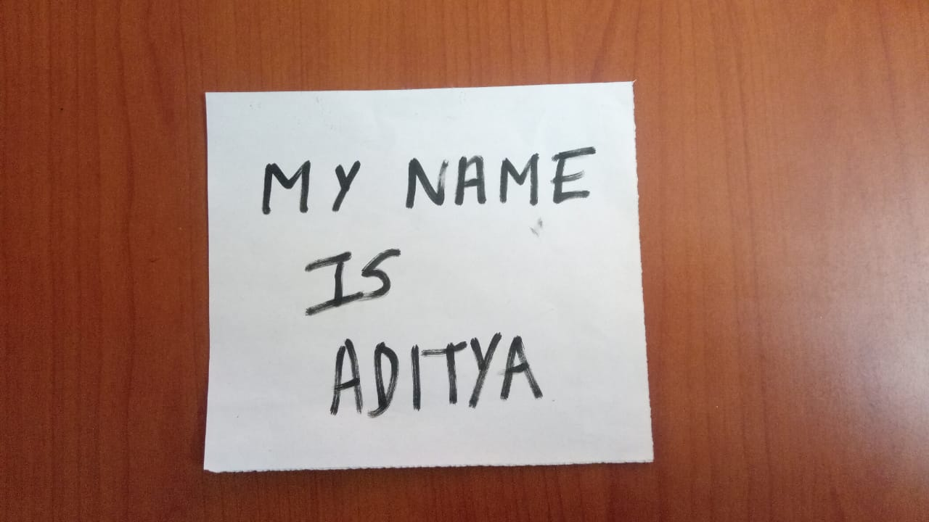
Original Image

Slide 27
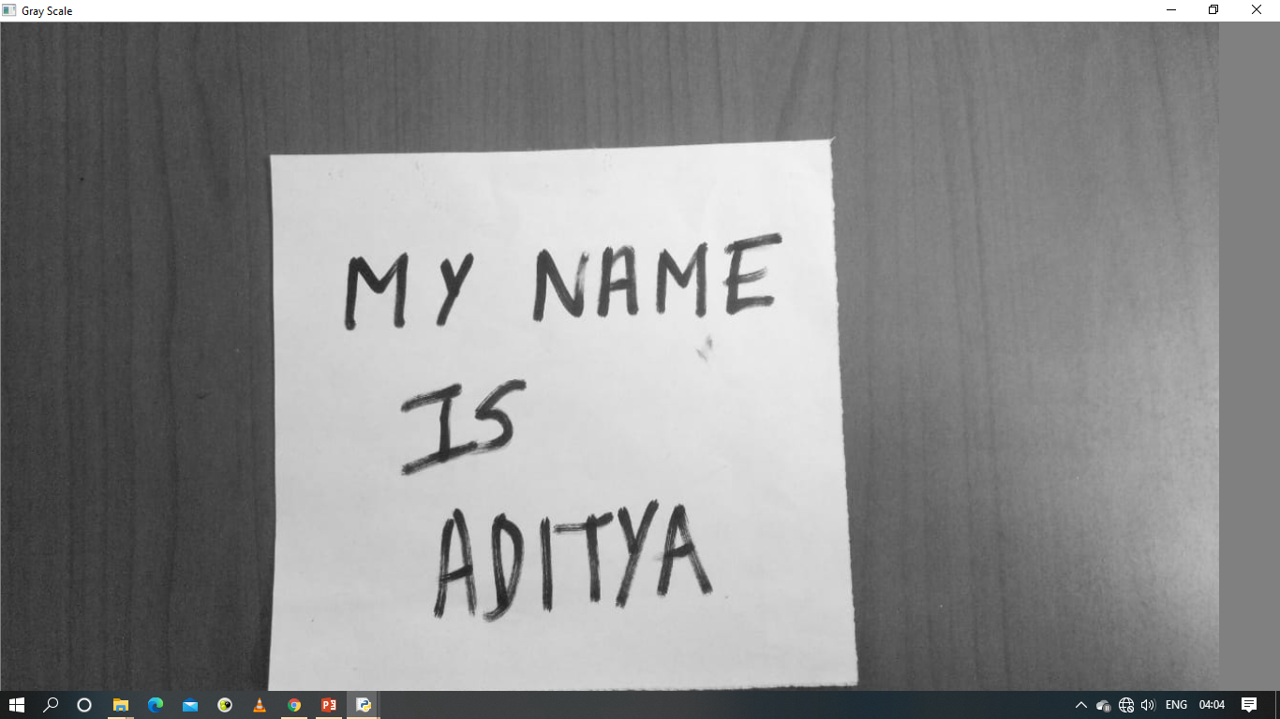
Output after running the Python Code for Scanner.py First we get the gray scale image entitled “Gray Scale” as output.

Slide 28

Secondly we get the Blurred Image entitled “Blur”

Slide 29
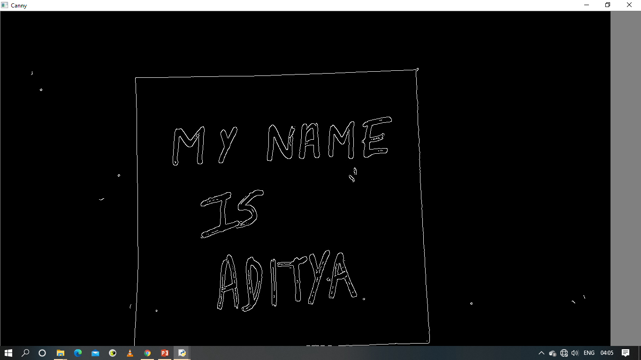
Thirdly we get the Canny Detected Image entitled “Canny”

Slide 30
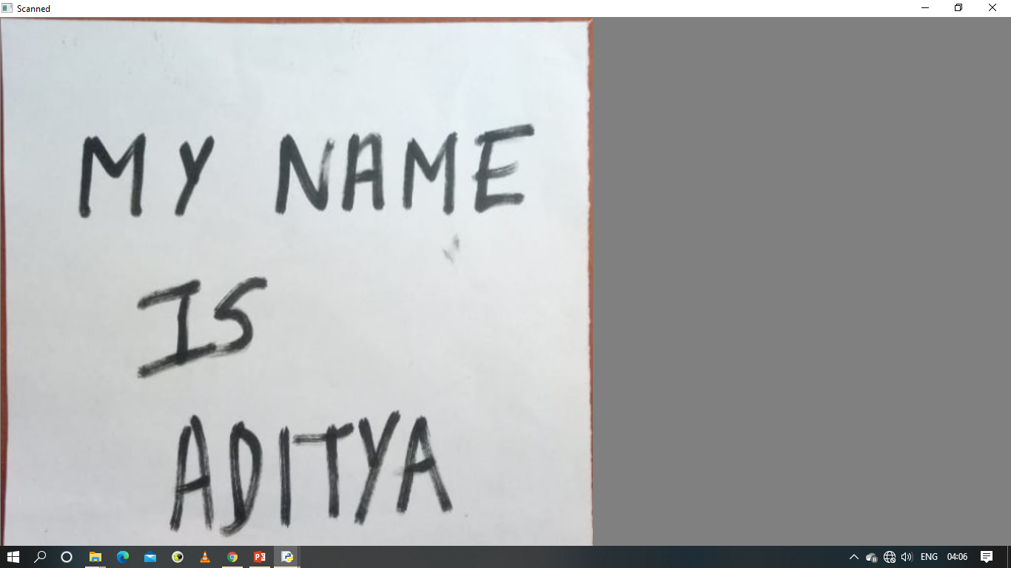
Fourthly we get the Scanned Image entitled “Scanned” which is the final output.

Slide 31
Conclusion
This python script takes an image as input and then scans the document from the image by applying few image processing techniques and gives the output image with scanned effect.

Slide 32
THANK YOU

